Slide 1
GIS and RS for Forest Resource Assessment
Kefyalew Sahle Hawassa University
Wondo Genet College of Forestry and Natural Resources
GIS Department

Slide 2
Unit 6. Forest biomass estimation
Practical on use of lidar data

Slide 3
Analysis of LiDAR data
Remark:
Lidar data can be analysis using various packages such as LAStool and lidR. lidR is an R package for analysis of Airborne Laser Scanning (ALS) data.
In this practice we use lidR.

Slide 4
Introduction
Lidar point clouds and their derived products have become an important source of detailed spatial information for invironmental research.
The data contained in a lidar point cloud can be analysed in multiple different ways and lends itself to detailed statistical modelling.
Processing point clouds directly can be challenging due to the size of the files.
Very large data sets covering regions, rather than sites, are thus best processed on more powerful platforms than a laptop computer.
However smaller areas can easily be analysed using open source or free tools.

Slide 5
What does Lidar data consist of?
Raw lidar data is fundamentally quite simple in structure.
It consists of a cloud of points with x, y and z coordinates.
There are some components in addition to x,y,z that can be used in processing.

Slide 6
What does Lidar data consist of?
An important element is the intensity of the return and the order in which the return arrives at the sensor.
First returns represent the top of a forest canopy
Last returns have penetrated vegetation and thus usually return from the ground.
High intensity returns come from harder surfaces than low intensity returns.
The combination of the number of the return and intensity allows the points to be classified by running an algorithm over the data.

Slide 7
E.g. of classes
0 = Never classified
1 = Unassigned
2 = Ground
3 = Low Vegetation
4 = Medium Vegetation
5 = High Vegetation
6 = Building
7 = Low Point
8 = Reserved

Slide 8
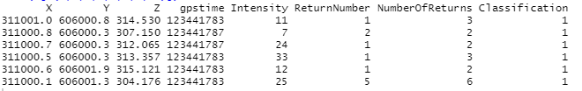
.g. of lidar data extracted only for demonstration

Slide 9
Common processing workflow in lidR
Airborne Laser Scanning (ALS) data processing relies on recurring steps that are systematically applied to a dataset.
An example of steps include
ground classification,
digital terrain generation,
digital surface model generation,
height normalistion of the point cloud and,
in the case of forestry applications,
individual tree segmentation (ITS) and / or
the area-based approach (ABA) analysis.
https://www.sciencedirect.com/science/article/pii/S0034425720304314

Slide 10
Classification of ground points
The classification of ground returns from an ALS point cloud is not only the first step towards generating a ground surface, but is also one of the most critical steps of the workflow.

Slide 11
Derivation of a Digital Terrain Model (DTM)
Once the classification of ground returns is complete, a digital terrain model (DTM) is derived, most commonly represented by an interpolated ground surface at user-defined spatial resolution.
DTMs also allow users to normalise the point cloud to manipulate relative elevations instead of absolute elevations.
The derivation of a DTM involves spatial interpolation between ground returns and is a critical step as its errors will impact directly on the computed point heights, and thus on tree height or derived statistic estimation.

Slide 12
Derivation of a Digital Terrain Model (DTM)
Three implementations of interpolation routines to derive the DTM are currently included in lidR:
(a) triangular irregular network with linear interpolation using a Delaunay triangulation,
(b) inverse-distance weighting, and
(c) kriging.

Slide 13
Data normalisation
A common third step in ALS data processing is the subtraction of the terrain surface from the remaining ALS returns (the above below).
Point cloud normalisation removes the influence of terrain on above-ground measurements, thus simplifying and facilitating analyses over an area of interest.

Slide 14
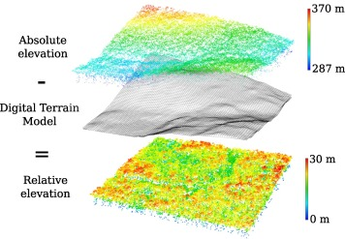
Graphical representation of data normalisation
Graphical representation of data normalisation consisting of subtracting a ground surface to remove the influence of terrain on the height of above-ground points.

Slide 15
The most common approach to normalise non-ground returns
is to subtract the derived raster DTM from all returns.
has been widely used and is simple and easy to implement.
For each point in the dataset, the algorithm selects the value of the corresponding DTM pixel, then subtracts this value from the raw elevation value of each point.
The approach, while simple, can lead to inaccuracies in normalised heights due to the discrete nature of the DTM and the fact that the DTM was created and interpolated using regularly spaced points, which do not match the actual location of the ground points in the dataset.

Slide 16
A second normalisation method
A second normalisation method utilises all returns, with each ground point interpolated to its exact position beneath the non-ground return.
This approach therefore removes any inaccuracies attributed to the abstract representation of the terrain itself.
Using this method, every ground point used as reference is exactly normalised at 0, which is the expected definition of a ground point that is independent of the quality of the ground segmentation.

Slide 17
generate either a DTM, or to normalise the point-cloud
In lidR, spatial interpolation can be applied for any location of interest to generate either a DTM, or to normalise the point-cloud using an interpolation between each point.
While normalising the point-cloud bears several advantages for subsequent analyses, there are also some drawbacks.
The normalisation process implies a distortion of the point cloud and, therefore, of the sampled above-ground objects, such as trees and shrubs.
Because this can be exacerbated in areas of high slope (see the next figure), some authors have chosen to work with raw point-cloud to preserve the geometry of tree tops.
In lidR, normalisation is easily reversible by switching absolute and relative height coordinates allowing versatile back and forth representations from raw to normalised point clouds if desired.

Slide 18
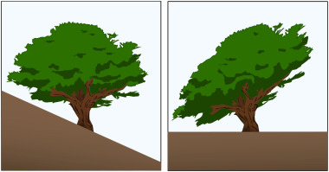
Illustration of the effect of normalisation
Illustration of the effect of normalisation on the geometry of objects such as trees located on slopes. The effect is exacerbated by the slope of the terrain and the horizontal dimensions of the object.

Slide 19
Derivation of Canopy Height and Surface Models
The Canopy Height Model (CHM) is a digital surface fitted to the highest non-ground returns over vegetated areas.
It can be interpreted as the aboveground equivalent of the Digital Terrain Model (DTM).
It differs from the Digital Surface Model (DSM), which is the non-normalised version of the same surface. In this material, the term Digital Canopy Model (DCM) is used to capture both surfaces.

Slide 20
to create DCMs
The two main algorithms used to create DCMs can be classified into two families:
(a) the point-to-raster algorithms and
(b) the triangulation-based algorithms. lidR provides both.

Slide 21
Point-to-raster algorithms
are conceptually the simplest and consist of establishing a grid at a user-defined resolution and attributing the elevation of the highest point to each pixel.
Algorithmic implementations are computationally simple and fast, which could explain. This is the default algorithm implemented in FUSION/LDV, LAStools and ArcGIS.

Slide 22
Point-to-raster algorithms
One drawback of the point-to-raster method is that some pixels can be empty if the grid resolution is too fine for the available point density.
Some pixels may then fall within a location that does not contain any points, and as a result the value is not defined.
A simple solution to this issue is post-processing to fill any gaps using an interpolation method such as linear interpolation or inverse distance weighting.

Slide 23
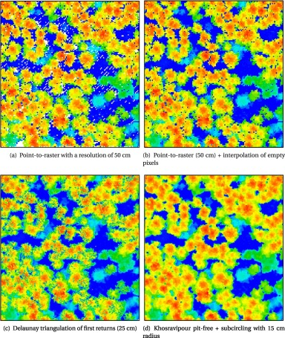
Four 100 × 100 m DCMs computed from the same point cloud using different methods from each of the two main families of algorithms. (a) Contains empty pixels because of the absence of points in some pixels (the highest point cannot be defined everywhere); (b) Empty pixels are filled by interpolation, but some pits remain; (c) The resolution was increased without empty pixels, but with many pits due to pulses that deeply penetrated the canopy before generating a first return; (d) Pit-free with high resolution.

Slide 24
Triangulation-based algorithms
Triangulation-based algorithms most commonly use a Delauney triangulation to interpolate first returns (the above figure (c)).
Despite being more complex than point-to-raster algorithms, an advantage of the triangulation approach is that it does not output empty pixels, regardless of the resolution of the output raster (i.e. the entire area is interpolated).
However, like the point-to-raster method, it can lead to gaps and other noise from abnormally low pixels compared to neighbouring areas.
The so-called ‘pits’ are formed by first returns that penetrated deep into the canopy.
To solve such issues, it was proposed a natively ‘pit-free’ algorithm, as well as ‘a spike-free’ algorithm.
The ‘pit-free‘ method consists of a series of Delaunay triangulations made sequentially using points with values higher than a set of specified thresholds.

Slide 25
Area-based approach
Once ground returns have been classified and a DTM developed, the so-called ‘area-based approach’ is commonly used to link the 3D structure of the point-cloud to forest attributes.
Conceptually simple, the ABA involves the computation of metrics that summarise the point cloud structure in a given area of interest, typically a 400 – 900 m2 square or circle, congruent with that of a conventional forest plot.
In the ABA, the grid cell represents the fundamental unit of measure. Metrics are then used in predictive statistical models to derive key ground-based inventory variables.
Predictions from such models can then be mapped over an area of interest.

Slide 26
Individual tree segmentation
An alternative method to the area based approach consists of calculating summaries of the point cloud at the scale of individual trees.
An accurate segmentation of individual trees to extract a database of tree-level position and attributes such as height, diameter, volume and biomass is a much desired outcome of research on the use of ALS for forestry applications.
Individual tree detection algorithms can be generally divided into two types i.e. those based on a digital canopy models and those utilising the point-cloud directly.

Slide 27
Overview of the key components of lidR that are presented in next slide
Most functions and processing avenues within lidR are designed for user-defined integration within a self tailored workflow.

Slide 28
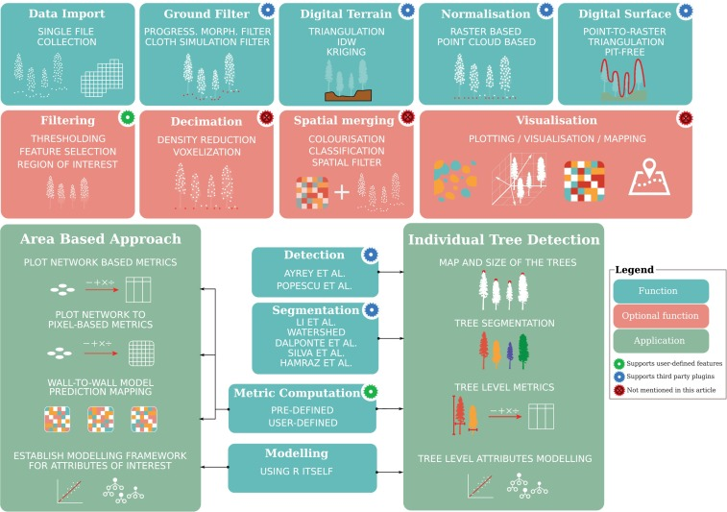

Slide 29
Practical on Lidar (group)
The instruction and the data are available in the lidardata folder.

